Slide 1
SharePoint Server 2010 Service Applications

Slide 2
Agenda
Managed Metadata Service
Business Data Connectivity Service
User Profile Service

Slide 3
Managed Metadata Service
Managed Metadata Service Application
Term Store
Content Type syndication
SharePoint Metadata Manager
Term & keyword field support in Office 2010 clients
Import of Managed Metadata data from another taxonomy store
Term & keyword integration in Office 2010 clients via Backstage
New managed metadata field type bound to a term set
Notes:
Managed Metadata service application:
Admins define term store (taxonomy).
Admins define the location of the Enterprise Content Type site collection hub.
Metadata Manager = utility used to manage the term store.
Admins can import a CSV file that contains a taxonomy into a new term store.
SharePoint 2010 now has a Managed Metadata field type that’s bound to a term set and used in tagging of List Items.

Slide 4
Enterprise Content Types
Content types were scoped at the site-level (SPWeb) in WSS 3.0
Site-level content types still exist in MSF
New Managed Metadata Service Application allows syndication of “enterprise” content types across sites, site collections, Web apps & farms
Define one site collection as the content type hub
Enterprise content types are read only in sites
Sites can have enterprise and local content types in sites
Local content types can inherit from enterprise content types
Notes:
Enterprise Content Types allow for consistent content types across multiple SharePoint site collections, web applications and farms.
In the Managed Metadata Service you can define a site collection that will serve as a central repository of content types.
Content types that are syndicated can’t be changed in the child sites, but site owners can create new content types that extend them to implement changes.

Slide 5
Metadata Everywhere
Huge investments in metadata across the platform
Metadata based navigation
Easier for users since content is more discoverable
Content stewards help in creating indices on metadata fields for enhanced navigational performance
Users can now filter search results using metadata of result set
Location based metadata
Content stewards create helpers for libraries & content types
Notes:
Metadata based navigation.
Ability to browse a document library filled with tagged content according to the taxonomy, ignoring the folder organization.
In the document library settings you can find the Metadata navigation settings hyperlink. This leads you to a page where you can configure navigation hierarchies based on the defined Managed Metadata.
The navigation hierarchy will be available on the Quick Launch.
When search results are shown, metadata (tags) are used as one of the search result refiners.
You can configure location-based metadata defaults in a hierarchy of folders. Subfolders and documents will inherit the metadata from the parent folder.

Slide 6
Term Store, Term Sets & Terms
Service Application (Term Store) » Groups » Term Sets » Terms
Locations » Cities » Redmond
Administrators & users create term stores & terms
Flat list or hierarchical list
Can have custom properties associated with each term
Disambiguating, reusing, merging & deprecating terms
Term store facilitates the management & retrieval of metadata & relationships
Terms can belong to one or more term sets
Translations & synonyms
Notes:
A central taxonomy can be defined using the Term Store Management Tool. This tool is part of the Managed Metadata service application, and can be accessed either from Central Administration or from within Site Settings.
Administrators and users can create term stores and terms.
You can add a column of type Managed Metadata to a document library and map it to a term in the taxonomy.
Metadata managers create the taxonomy which consists of a hierarchy of tags:
Tags can have translations and synonyms (United States = US or USA).
There are many controls you can implement on tags… from reuse to merge to deprecating & disambiguating.
Each tag has a property bag of custom properties that is available via the OM.

Slide 7
Keywords & Tags
Keywords
Free text with no enumerable sources
Like tags but without enterprise characteristics (synonyms, translations, hierarchical, etc.)
Can be promoted to a term & vice versa
Tags
Can be terms or keywords
Shell Tags:
Saved & kept in sync with the item’s managed keyword field
Social Tags:
Allows users to create and apply keywords to items
Stored in social store, not with the item itself
Notes:
Keywords:
No structured organization… users can enter at will.
Keywords are stored in a non-hierarchical list called the keyword set.
Keywords have no synonyms or translations.
Admins can promote a keyword to a term in the taxonomy.
Tags:
Users can tag items
A term from the taxonomy will be suggested but the user can fill out something else.
These are things that are directly associated with a file.

Slide 8
Metadata Manager
Provides rich interface for full management of term sets and terms
Import of term sets and terms
Manage custom properties (via API)
Translations & synonyms
Manage term set / term languages
Submission policy (open / closed)
Open means users can submit terms to the term store (when adding / editing items)
Regardless of the policy, users can always submit keywords
Notes:
The metadata manager offers full control over the management of the terms within term sets.
Terms and custom properties can be managed using the SharePoint Object Model. The classes reside in the Microsoft.SharePoint.Taxonomy namespace of the Microsoft.SharePoint.Taxonomy.dll. The namespace holds classes like:
TaxonomySession
TermStore
Group
TermSet
Term
The term set policy can be set to:
Open – anyone can contribute to it.
Closed – only admins can contribute to it.

Slide 9
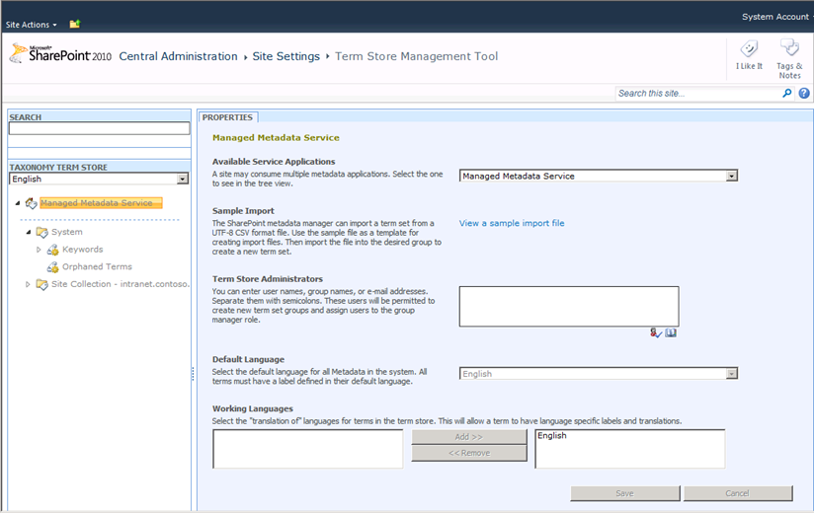
Term Store Manager
Notes:
The Term Store Management Tool helps defining Term Stores, Term Sets and Terms. It’s a centralized store that allows term sets to be shared across a farm. It also provides support for translations.

Slide 10
DEMO
Working with Managed Metadata

Slide 11
Agenda
Managed Metadata Service
Business Data Connectivity Service
User Profile Service

Slide 12
Challenges With Back End Data End Users
Multiple user interfaces
External systems can be difficult to use
Can't work with the data when and where I want to
Can’t easily search for business data
Need to involve IT to service my requests for data access
Notes:
SAP, Siebel, Dynamics CRM, databases, web services, other external sources. Need to learn how to work with external data. Can’t do it from mobile phone or browser. No self service. Very dependent on IT.

Slide 13
Challenges With Back End Data IT Professionals / Administrators
Islands of business data
Overhead for IT to service all user requests
Manage security, auditing, connectivity
One-off projects for connecting to external systems
Notes:
Everyone is creating their own solution. Hard for IT to manage all one off projects.

Slide 14
Business Connectivity Services
Bring data from external systems into SharePoint and Office, interact with it, reuse it, and empower end users to gain insight into the underlying data in a reusable way.
Extend the reach of Enterprise Data
Centrally manage reusable connections
Easily create custom solutions
Notes:
BCS is a set of out-of-box features, services and tools that streamline the creation of SharePoint Solutions with deep integration of External Data and Services. Power users, IT, Devs can create no code solutions using BCS.
The basics of ECT store and BDC runtime are baked into the SPF platform.
Why BCS?
Integrate other Line of Business application systems with SharePoint sites.
Search for data in other systems via the SharePoint Search service.
Save the time, cost, and monotony of writing yet another data layer!

Slide 15
BCS Terminology
Business Connectivity Services: All rolled up
Business Data Connectivity (BDC): plumbing, runtime, connectivity
External Data: Target systems (ie: LOB’s)
External Content Type (ECT): Definition of external data
Model: XML file (Application Definition)
External List: Newest type of SP list
Notes:
BCS: Umbrella term – presentation, connectivity, tools in SharePoint and Office.
BDC: Object model, plumbing pieces (used to be Business Data Catalog).
External System: Line of Business Apps.
ECT: similar to entity in SP 2007. Objects when they come into SharePoint and Office.
Model: what used to be AppDef file. Collection of external content types.
External List: Way to expose LOB data in SharePoint.

Slide 16





BCS Components
Office Applications
BCS Client
Design Tools
SharePoint
Dev Platform
Business Intelligence
Enterprise Content Management
Collaboration Social
Enterprise Search
SharePoint Designer
External Lists
Visual Studio
External Content Type Repository
Business Data Connectivity
Database
Web Service
.NET Assembly Connector
Notes:
BCS connects to external sources to bring data in SharePoint and Office. Stores and secures ECTs – core building block for BCS. ECTs also define the object will behave in Office. External Lists bring in data into SharePoint as native first citizen data. Work with data as you work with other SharePoint lists.
BDC stores and secures ECTs and related objects in metadata store. BDC runtime uses data in BDC metadata store to understand how to interact with the backend systems. BDC is a service application and can be enabled from central admin. BDC client runtime connects directly to the backend source. Client data cache accessible through SP workspace.
Business Connectivity Services is composed of many pieces:
Office Client – By connecting to SharePoint, Office clients can consume data from the external systems.
SharePoint Server – SharePoint houses the external content types (ECTs) which is the backbone of the entire system.
External Data – this is the source of where the data is coming from.

Slide 17
External Lists in SharePoint
Expose external data as a native SharePoint list
Full CRUD capability
Familiar UI and navigation
Sort, Filter, Group
Programmatic access via SPList OM
Profile page available for each item in the list
Form
Auto-generated OOTB
Upsize to InfoPath
Offline-able
Notes:
Data in External List is stored in external system and not in SharePoint.

Slide 18
Surfacing External Data
External Data Columns
Add data from external content types to standard SharePoint lists
Can be made available as Content Controls in Word
Web Parts
Scenario: Use for Dashboard pages
External Data List
External Data Item
External Data Item Builder
External Data Related List
External Data Connectivity Filter
Chart Web Part
External Data Search
Integrate External Data into search results

Slide 19
BCS Security Overview
Popular Authentication Options | WCF Service Connector | Database Connector | .NET Assembly Connector
SQL Auth | N/A | Yes | Code-Based
UserName & Password | Yes | Yes | Code Based
NTLM Pass through | Yes | Yes | Yes
Claims Token | Yes | No | Code Based
OpenID / LiveID | Code Based | No | Code Based
Notes:
When accessing external data from a supported Office client application, two systems are involved: the client computer of the logged on user and the external system.
Outlook 2010 users typically use external data in Outlook items such as Contacts or Tasks. SharePoint Workspace 2010 users can take external lists offline and interact with them. Word 2010 users can insert external data into Word documents.
The Office Integration Client Runtime acts as a connector between Microsoft Business Connectivity Services running on the client and the supported Office applications.
If the external data is configured to use claims-based authentication, the client interacts with the Security Token Service on the SharePoint farm to get a claims token.
The BDC Client Runtime on client computers uses the data from the Business Data Connectivity service to connect to and execute operations on external systems for rich client access.
The Client Cache caches information from the Business Data Connectivity service and Secure Store Service that is needed to securely connect to external data. The cache is refreshed from the SharePoint farm to incorporate updated information.
The client Secure Store Service enables end users to configure their security credentials.
Microsoft Business Connectivity Services can pass credentials to databases and claims aware services.

Slide 20
Agenda
Managed Metadata Service
Business Data Connectivity Service
User Profile Service

Slide 21
Business System Centric Systems
User 1
User 6
User 2
Business System
User 5
User 3
User 4
Notes:
Usual business schemes are very much business system centric. All player work on the same system but from different perspectives.

Slide 22
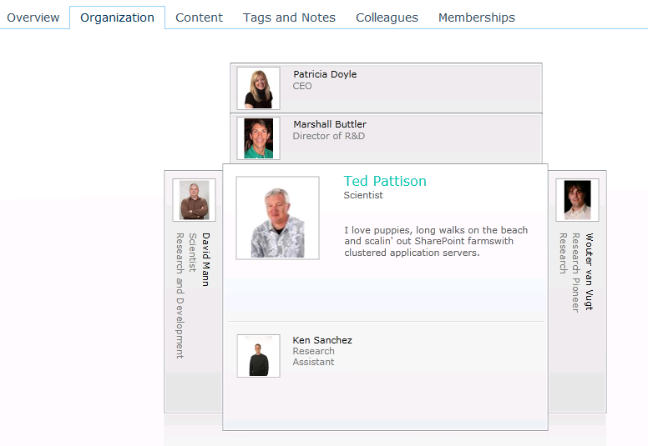
Social Computing Features
User Profiles
Rich Object Model
User Profile Web Service
Social Data
Tags, Comments, & Rating
Activity Feed
Social Data Service
Organization Browser
Notes:
People Data: The User Profile is there for you it and was good in 2003, got better in 2007 and in 2010 has still more advances.
The Activity Feed (I think) is the most significant new feature related to Social in SharePoint 2010. Consider the Activity Feed as a new alert channel.
A vehicle for notification of events from around your enterprise, not just SharePoint. Using Activity Templates you can craft your of communications channels for your users.
We’ll touch on Activities today and as they mature you will see much more content on how to use them.

Slide 23
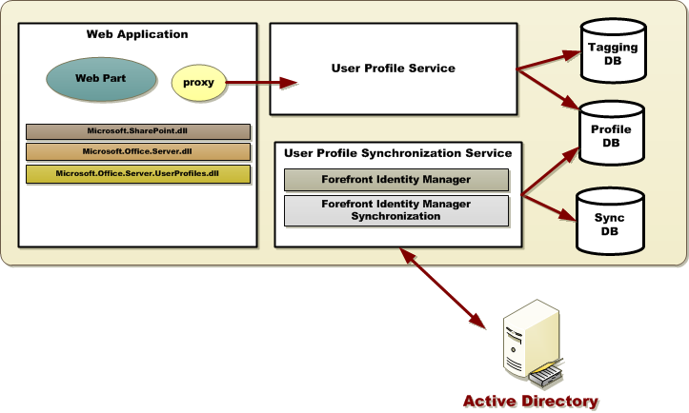
Architecture

Slide 24
Profile Store Architecture
User Profile DB
Profile and Activity Feed
Social Data DB
Tags, Keywords, Comments, Bookmark, Ratings
Mainly stores GUID (to the taxonomy term) or the note or rating, URI, Profile ID, Timestamp, URI disambiguation info
Term values for use on the Newsfeed and Tags & Notes Page
Sync DB
Staging sync data for AD, LDAP, BCS

Slide 25
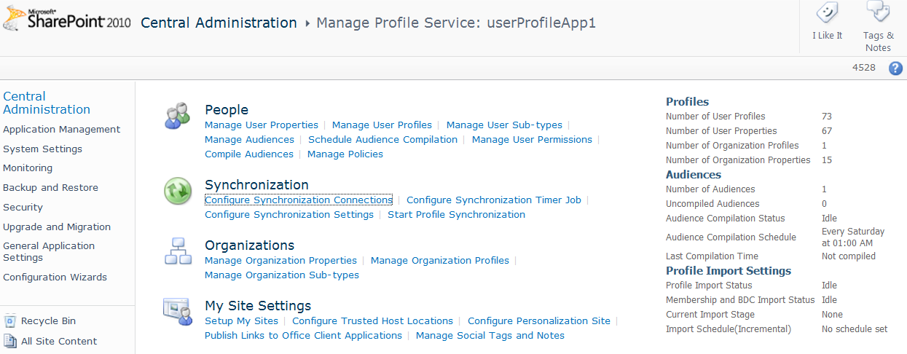
Key User Profile Service Considerations
Profile Customization
Profile Store architecture
Profile Synchronization
Scale
Performance
Federation and Replication

Slide 26
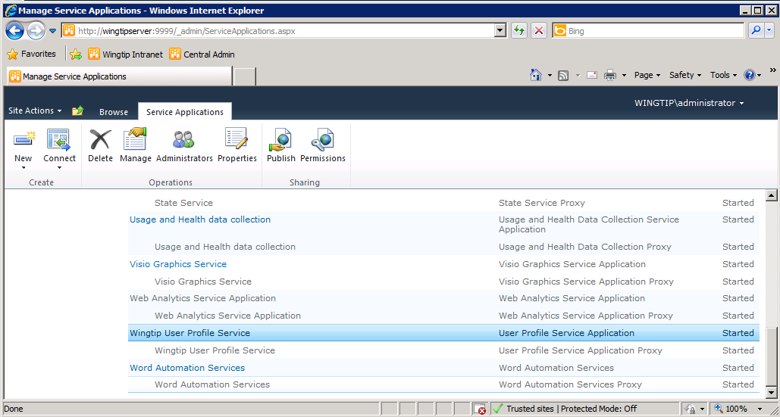
Service Application Management

Slide 27
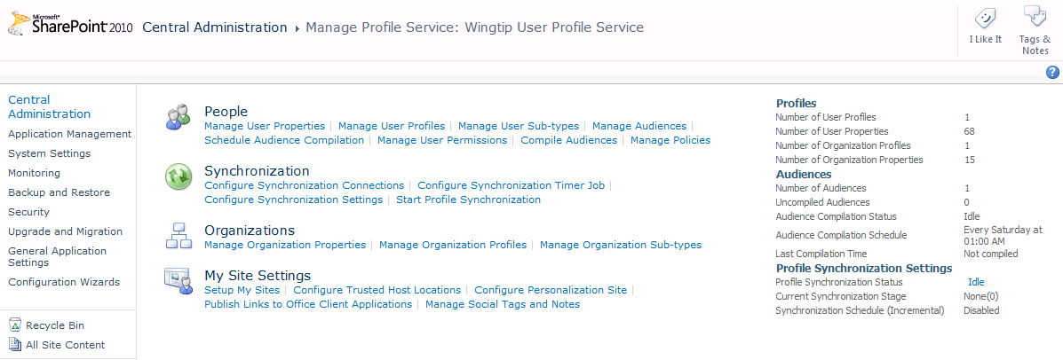
UPS Administration

Slide 28
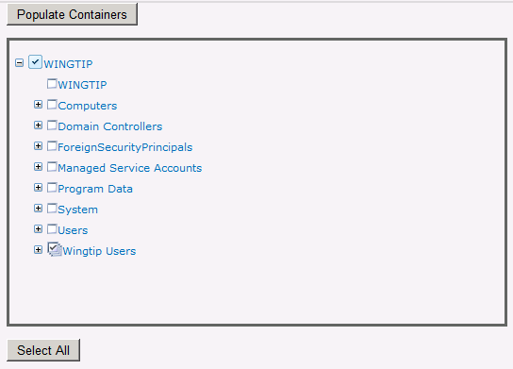
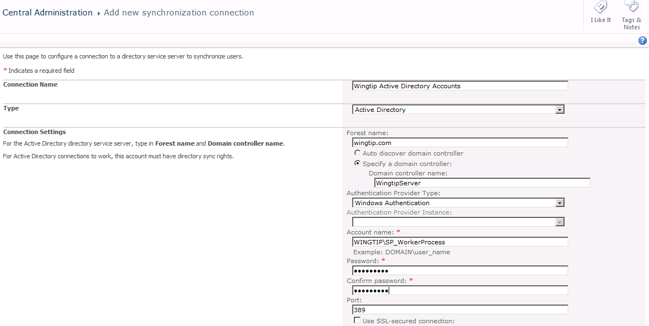
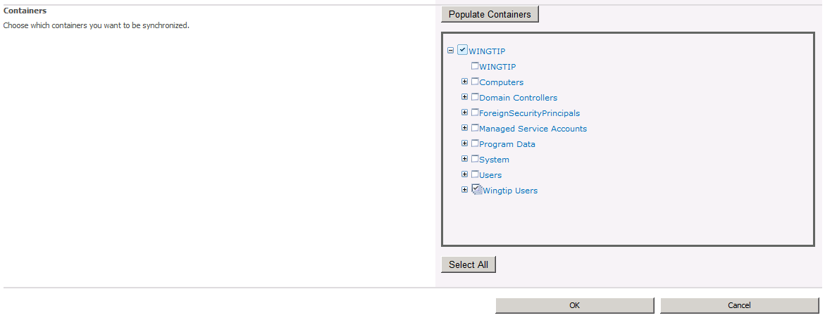
Configuring Sync Connections
Only select the appropriate OU
The Select All button is evil!

Slide 29
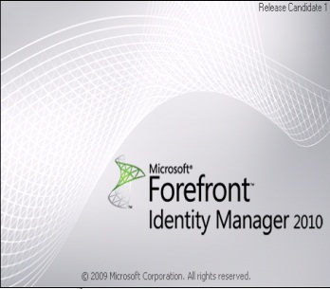
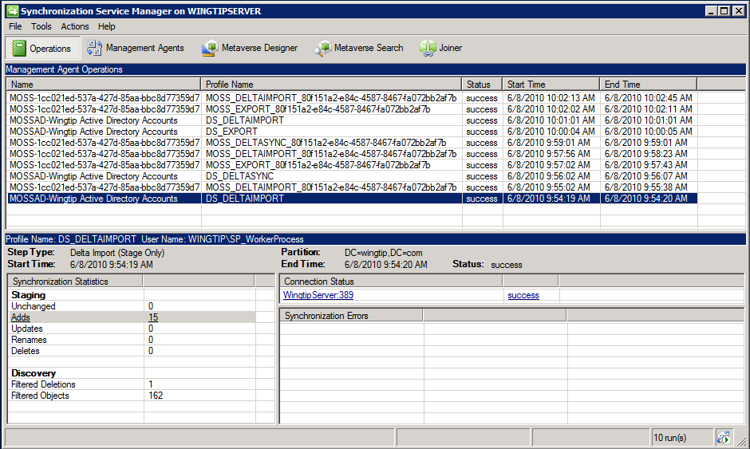
Forefront Identity Manager 2010

Slide 30
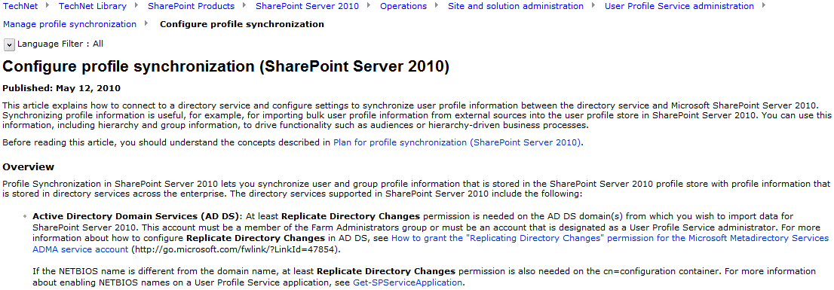
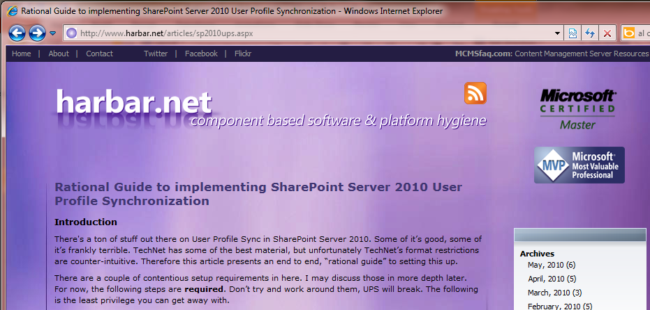
Getting Started Setting Up the UPS
http://technet.microsoft.com/en-us/library/ee721049.aspx
http://www.harbar.net/articles/sp2010ups.aspx

Slide 31
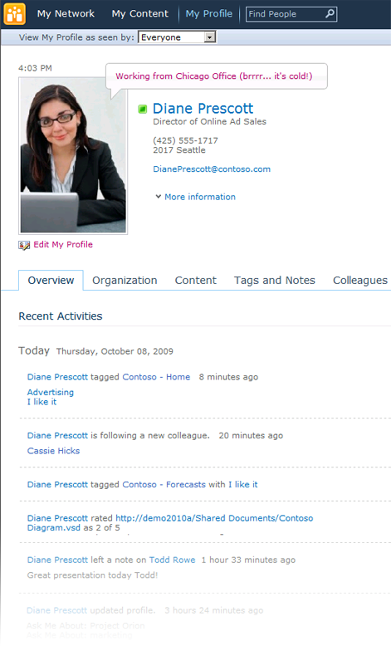
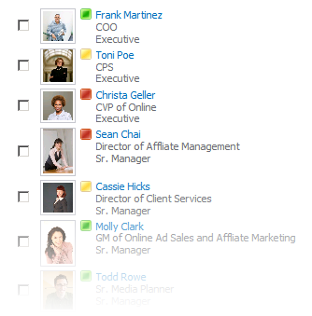
My Site
My Site personal portal
Social Feedback
People and Expertise Search
Notes:
My Sites also have a Note Board feature which works very much like the Facebook Wall where any one of your colleagues can write a message for you.
The My Network page in a My Site is a built in newsfeed. A running newsfeed of your colleagues’ activities (birthday, someone added a Tag, uploaded a document,etc.).
The My Profile page of the My Site also provides the user a microblogging platform sort of like Twitter.

Slide 32
My Site Components
My Network
My Profile
My Content
My <foo>
Pages
My Site
MySite Host
My Site
My Site
Site
Collections
My Web application
Web App
Managed Metadata
User Profiles
Search
Service
Application
Proxies
Notes:
My Sites are individualized sites created for each user profile that contain personal information about the user as well as personal and public views of information, documents, and other content. My Sites allow individuals to add colleagues and organize them into logical groupings. By using My Sites, users can keep track of their own activities as well as their colleagues.

Slide 33
Summary
Managed Metadata Service
Business Data Connectivity Service
User Profile Service

